Slide 1
Sales Analysis
using Dashboards

Slide 2
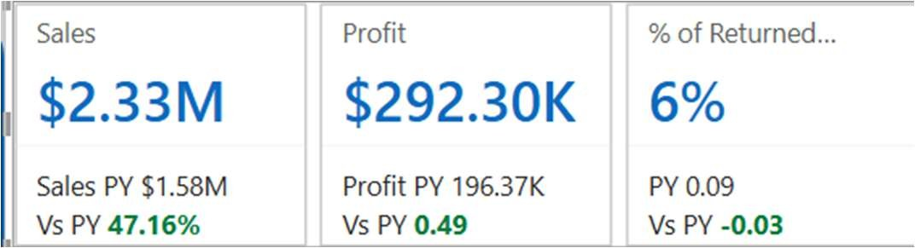
Use of KPI
"The dashboard highlights three key KPIs: Total Sales to track overall revenue, Profit to measure business profitability, and % Returned Orders to monitor product return trends and improve operational efficiency."

Slide 3
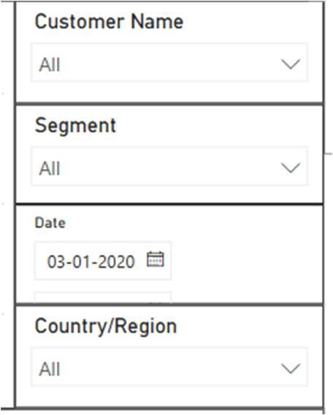
Slicers and Filters
◆ "Four slicers – Segment, Country, Date, and Customer Name – enable users to customize views and drill down into specific data points with ease."

Slide 4

Navigation Menu
◆ "Interactive navigation buttons link the main dashboard to the Q&A and City pages, enabling seamless exploration of detailed city-level metrics and instant answers to ad-hoc queries."

Slide 5
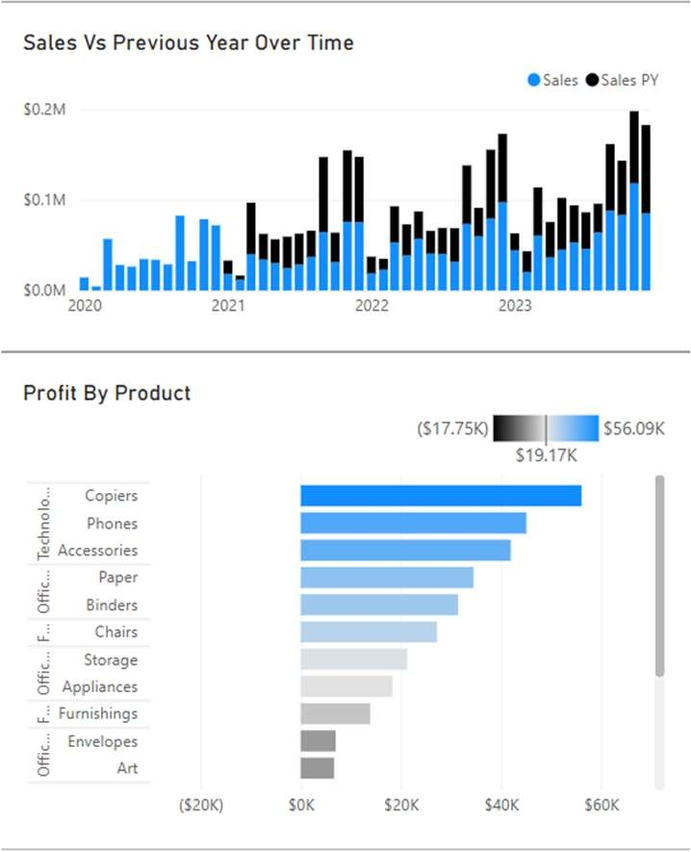
Suitable Visual for Describing the Story
"To ensure accurate data representation, a Clustered Bar Chart was selected for analyzing Profit by Product, while a Line and Stacked Column Chart effectively illustrated Sales performance compared to the previous year over time."

Slide 6
Time-series analysis
◆ "To facilitate time-series analysis, a Date Table was created and marked as the official date table in Power BI, enabling functions like Year-over-Year and Month- over-Month comparisons."

Slide 7
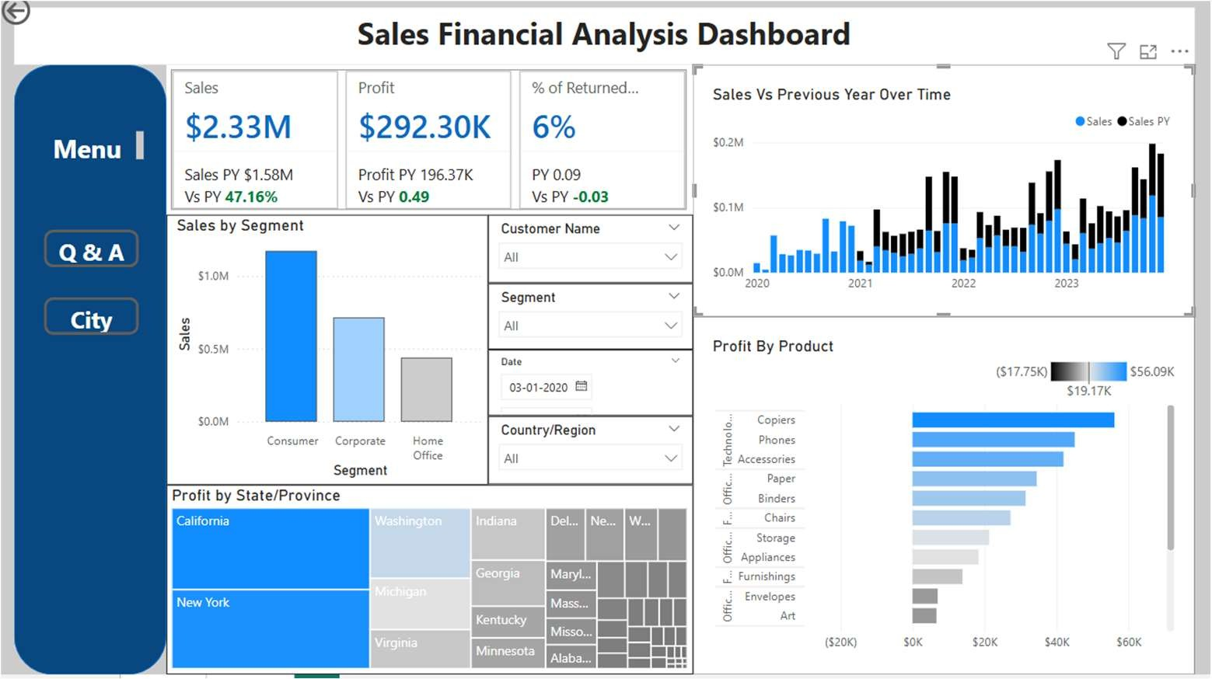
Final View
"The completed dashboard delivers a comprehensive view of Sales, Profit, and Returned Orders, equipped with dynamic slicers, time- series analysis, and intuitive navigation for deeper exploration and better decision-making."

Slide 8
Links
◆ Interactive Dashboard
◆ https://app.powerbi.com/groups/me/reports/eaaf8329-c65c-4465-ab35- 3de534b03a4a/bc3a135d1153a25b704b?experience=power-bi

